Slide 1
Computer network UNIT IV
Internetworking

Slide 2
Internetworking : Internetworking refers to the process of connecting different networks to form a larger network.
It involves using devices and technologies that allow data to flow between different types of networks, ensuring seamless communication across various infrastructures.
Example of internetworking is the Internet itself.

Slide 3
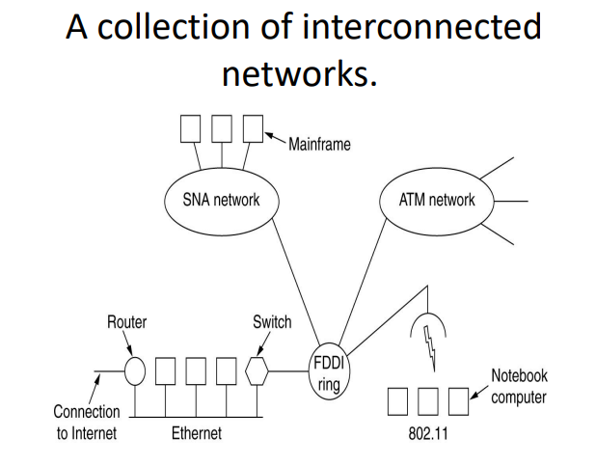

Slide 4
As an example of how different networks might be connected, consider the example of Fig .
A corporate network with multiple locations tied together by a wide area ATM network.
At one of the locations, an FDDI optical backbone is used to connect an Ethernet, an 802.11 wireless LAN, and the corporate data center's SNA mainframe network.

Slide 5
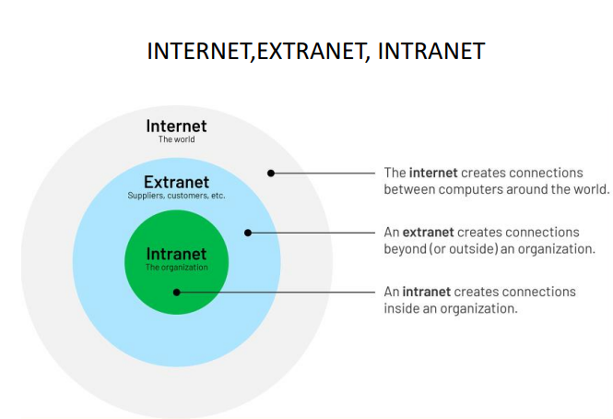
There are three variants of internetwork or Internetworking, depending on who administers and who participates in them :
Internet
Extranet
Intranet

Slide 6
Internet – A selected Internetworking, consisting of a worldwide interconnection of governmental, academic, public, and personal networks based mostly upon the ARPANET.
An Extranet is an organization's private network and its available only for selected users. It's a way to connect to third parties like vendors, customers, and partners in a secure and controlled way.
An Intranet is a private local network that enables employees within an organization to create content, communicate, and collaborate.

Slide 7
Tunneling
Tunneling is a protocol that allows for the secure movement of data from one network to another.
Tunneling involves allowing private network communications to be sent across a public network, such as the Internet, through a process called encapsulation.
If they are two geographically separate networks, which want to communicate with each other, they may deploy a dedicated line between or they have to pass their data through intermediate networks.

Slide 8
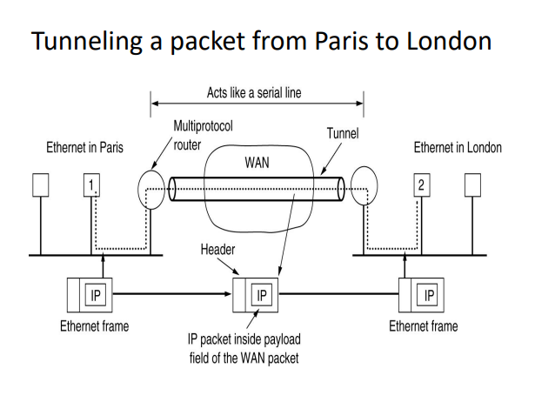

Slide 9
Tunneling is configured at both ends.
When the data enters from one end of Tunnel, it is tagged.
This tagged data is then routed inside the intermediate or transit network to reach the other end of Tunnel.
When data exists the Tunnel its tag is removed and delivered to the other part of the network.
Both ends seem as if they are directly connected and tagging makes data travel through transit network without any modifications

Slide 10
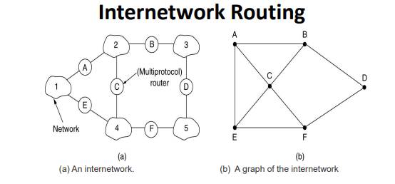
Internetworking is the process or technique of connecting different networks by using intermediary devices such as routers or gateway devices.
Internetworking ensures data communication among networks owned and operated by different entities using a common data communication and the Internet Routing Protocol.

Slide 11
Packet Fragmentation
Most Ethernet segments have their maximum transmission unit (MTU) fixed to 1500 bytes.
A data packet can have more or less packet length depending upon the application.
Devices in the transit path also have their hardware and software capabilities which tell what amount of data that device can handle and what size of packet it can process.

Slide 12
If the data packet size is less than or equal to the size of packet the transit network can handle, it is processed neutrally.
If the packet is larger, it is broken into smaller pieces and then forwarded. This is called packet fragmentation.
Each fragment contains the same destination and source address and routed through transit path easily.
At the receiving end it is assembled again.

Slide 13
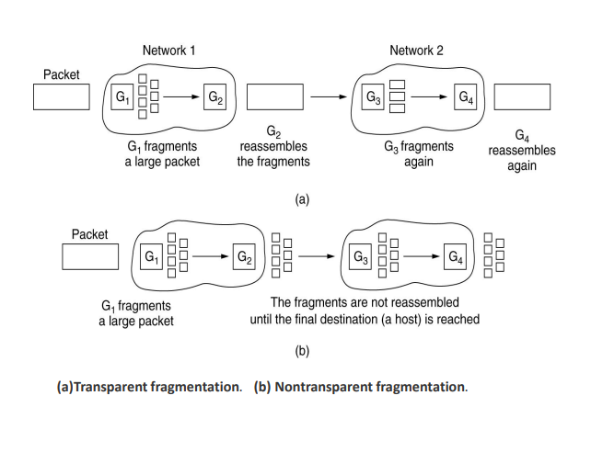
Transparent and Non Transparent Fragment

Slide 14
Transparent Fragmentation - the router doing the fragmentation breaks up oversized packets and addresses them all to the same exit router.
The exit router re-assembles the fragments and forwards original packet. This is called transparent fragmentation because it is invisible to the other networks in the path and to the hosts.
Problems in Transparent Fragmentation:
1) All packets must exist the same router; doesn't work for a connectionless network.
2) Overhead and delay involved with repeated fragmentation and reassembly.

Slide 15
Nontransparent Fragmentation - once a packet is fragmented, it is not reassembled until it reaches the destination.
Problems in Nontransparent Fragmentation: •
1) Overhead is increased since the ratio of data to header is worse.
2) Every host must be able to reassemble.
3)Multiple layers of fragmentation are possible.

Slide 16
Internet Protocol Version 4 (IPv4)
The IPV4 Protocol
An appropriate place to start our study of the network layer in the Internet is the format of the IP datagrams themselves.
An IP datagram consists of a header part and a text part.
The header has a 20-byte fixed part and a variable length optional part. The header format is shown in fig.

Slide 17
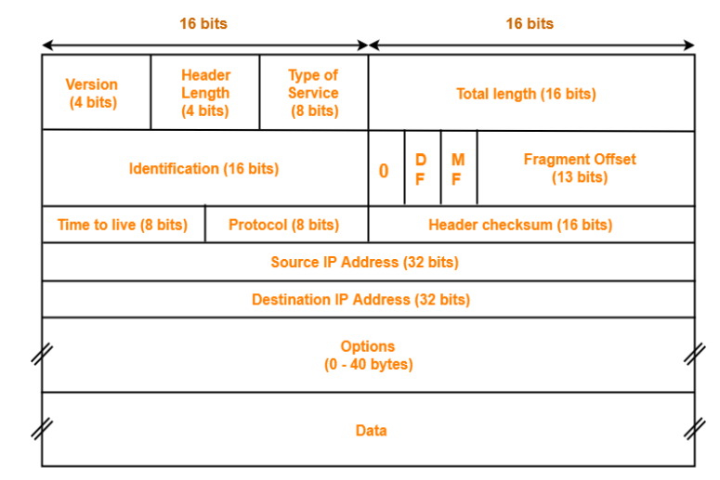
IPV4 HEADER

Slide 18
Version field :IPv4-0100 or IPv6-0110 The Version field keeps track of which version of the protocol the datagram belongs to. By including the version in each datagram, it becomes possible to have the transition between versions take years, with some machines running the old version and others running the new one.
Currently a transition between IPv4 and IPv6 is going on, has already taken years, and is by no means close to being finished.
Header length :Since the header length is not constant, a field in the header, IHL, is provided to tell how long the header is, in 32-bit words. Datagram Header size 20-60 Bytes and payload 0-65515 Bytes.

Slide 19
Type of service :It was and is still intended to distinguish between different classes of service. Various combinations of reliability and speed are possible. For digitized voice, fast delivery beats accurate delivery. For file transfer, error-free transmission is more important than fast transmission.
Differentiated services code point precedence 3 bits ,Delay 1 bit, Throughput 1bit,Reliability 1 bit, Cost 1bit,last bit 0 reserved bit.
Total length :The Total length includes everything in the datagram—both header and data. The maximum length is 65,535 bytes. At present, this upper limit is tolerable, but with future gigabit networks, larger datagrams may be needed.

Slide 20
Identification field :The Identification field is needed to allow the destination host to determine which datagram a newly arrived fragment belongs to uniquely identifies the packet.
DF stands for Don't Fragment. It is an order to the routers not to fragment the datagram because the destination is incapable of putting the pieces back together again.
MF stands for More Fragments. All fragments except the last one have this bit set. It is needed to know when all fragments of a datagram have arrived.

Slide 21
Fragment offset :The Fragment offset tells where in the current datagram this fragment belongs. All fragments except the last one in a datagram must be a multiple of 8 bytes, the elementary fragment unit.
Time to live field :The Time to live field is a counter used to limit packet lifetimes. It is supposed to count time in seconds, allowing a maximum lifetime of 255 sec.
It must be decremented on each hop and is supposed to be decremented multiple times when queued for a long time in a router. In practice, it just counts hops. When it hits zero, the packet is discarded and a warning packet is sent back to the source host.

Slide 22
Protocol field :The Protocol field tells it which transport process to give it to. TCP is one possibility, but so are UDP and some others. The numbering of protocols is global across the entire Internet.
Header checksum :The Header checksum verifies the header only. Such a checksum is useful for detecting errors generated by bad memory words inside a router.
The algorithm is to add up all the 16-bit halfwords as they arrive, using one's complement arithmetic and then take the one's complement of the result. For purposes of this algorithm, the Header checksum is assumed to be zero upon arrival

Slide 23
Source address and Destination address: The Source address and Destination address indicate the network number and host number. The Options field was designed to provide an escape to allow subsequent versions of the protocol to include information not present in the original design, to permit experimenters to try out new ideas, and to avoid allocating header bits to information that is rarely needed.
Options: The options are variable length. Each begins with a 1-byte code identifying the option. Some options are followed by a 1-byte option length field, and then one or more data bytes.

